Slide 2
SLCS Configuration

Slide 3
Agenda
Overview
Configuration
Adding/Deleting Cards
Static Cards
Dynamic Cards

Slide 4
SLSC Configuration Overview
Purpose
Configure SLSC boards in the rack
How
Send SPI commands to the MCP23S17 chips present on the SLSC boards which configure the boards for their intended purpose
Types
Static
Oxygen Sensor Calibration (UEGO)
Dynamic
Battery Switch (BATT)
Current Sense Calibration (Current Sense)
Fault Insertion (FIU)
LED Backplane (LED)
Digital Input/Output (DIO)
Simulated Resistance (Resistor)
Wheel Speed Sensor (WSS)

Slide 5
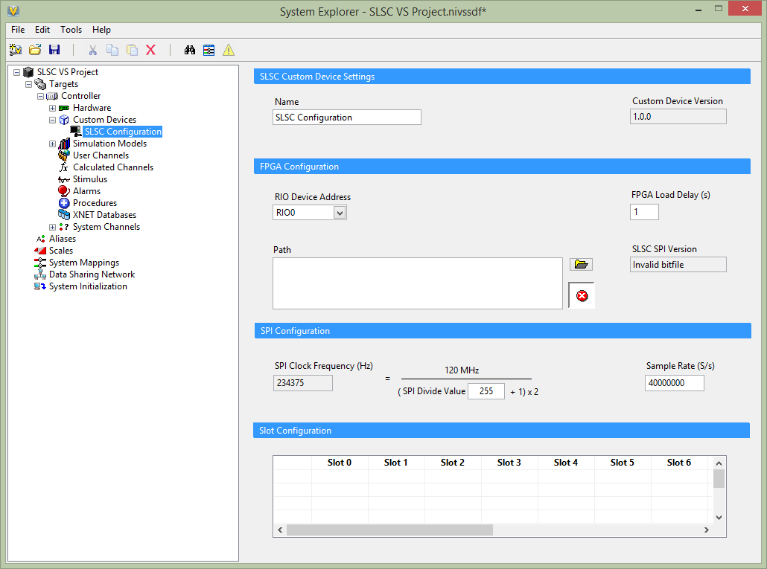
Custom Device Configuration
Notes:
To add the custom device, right-click on Custom Devices>>National Instruments>>SLSC Configuration. This will add an instance of the custom device to the system definition. When added the screen above will appear. You’ll notice that the SLSC SPI Version says Invalid bitfile. This is because a bitfile has not been selected. The user must select the bitfile which contains the SPI FPGA.

Slide 6
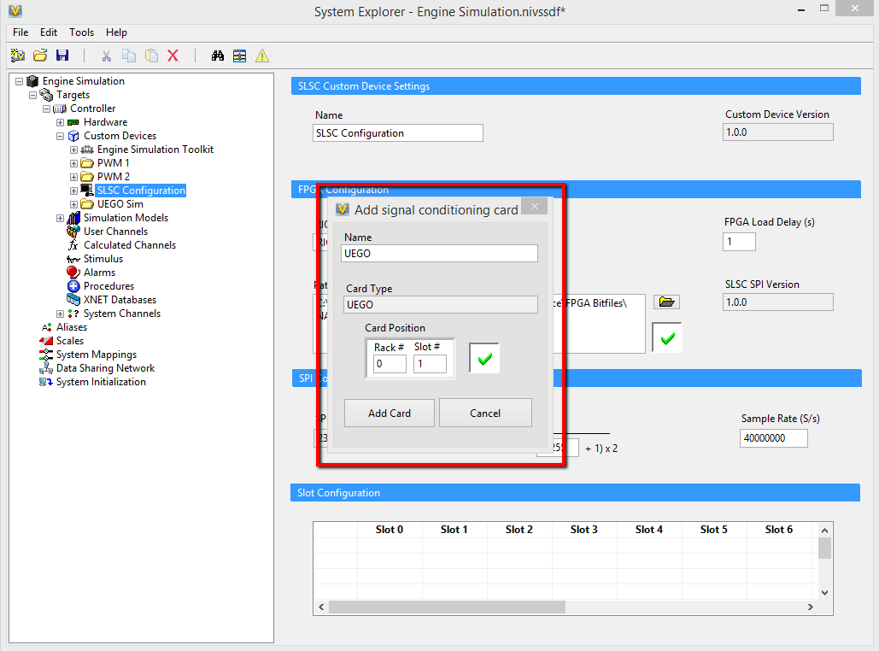
Custom Device Configuration
Notes:
Upon selecting the custom device a dialog may appear. This happens if Oxygen Sensor Simulation IP is found in the FPGA. Select the Rack # and Slot # that the UEGO card is present in, then select Add Card.

Slide 7
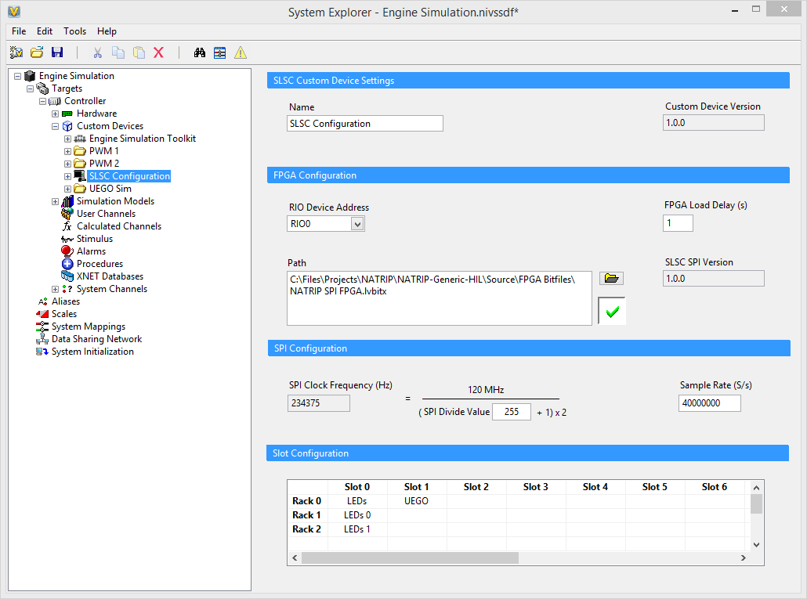
Custom Device Configuration
Notes:
The UEGO Card is then added to the specified slot. Also the backplane LEDs will be added to Slot 0. The SLSC SPI Version is updated and the bitfile is identified as valid. Also, the number of racks is updated in the table. Next the user will want to verify the settings for RIO Device Address are valid by comparing what is selected in MAX for that specific FPGA card. The user may also adjust the FPGA Load Delay (s), the SPI Divide Value, and the Sample Rate (S/s) if desired though the defaults should be suitable.

Slide 8
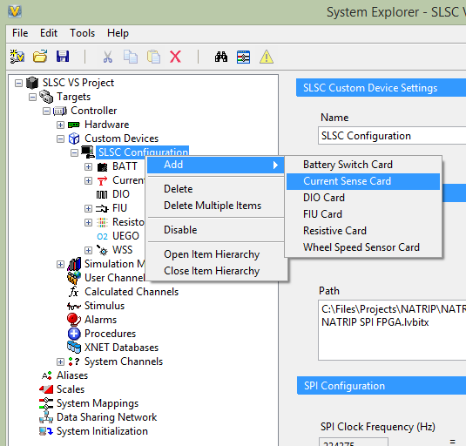
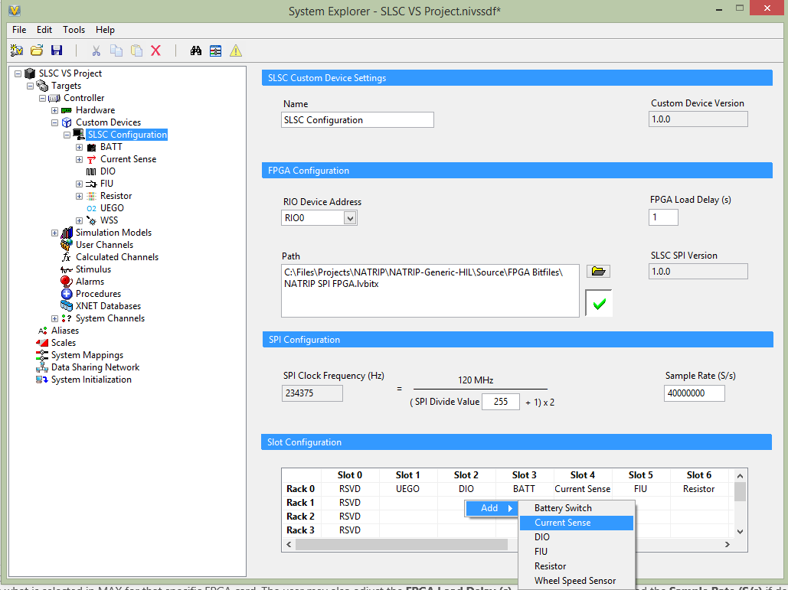
Adding/Deleting Cards & Navigation
Notes:
[Maybe best shown via demonstration] Cards can be added by right-clicking on the SLSC Configuration custom device in the hierarchy and selecting Add or the user can right-click on an empty slot in the Slot Configuration table and select Add. Deleting cards is similar. The user can right-click on the SLSC Configuration custom device in the hierarchy and select Delete Multiple Items to select multiple cards or right-click each card in the hierarchy and select Delete to delete individual cards. The user can also right-click on a non-empty slot in the Slot Configuration table and select Delete. Also, the user can double-click a card in the Slot Configuration table to load the configuration for that card.

Slide 9
Static Cards
Configuration occurs on deployment and cannot be changed while the system is still deployed
Types
Oxygen Sensor Calibration (UEGO)

Slide 10
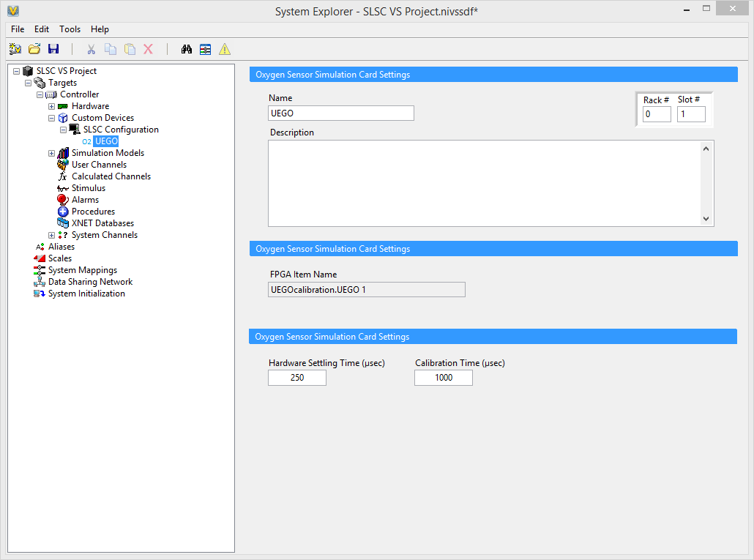
Oxygen Sensor Calibration (LS-2-2801)
Purpose
Calibrate the Oxygen Sensor Simulation on FPGA
Notes:
The Oxygen Sensor Calibration card is used to calibrate the Oxygen Sensor Simulation on FPGA when the FPGA is first deployed and running on the target. There are a few settings the user may set: Hardware Settling Time and Calibration Time. The default should be appropriate but the user may change these if desired. Also the user may change the rack and slot position.

Slide 11
Dynamic Cards
Initial configuration occurs on deployment and can be changed while the system is still deployed
Types
Battery Switch (BATT)
Current Sense Calibration (Current Sense)
Fault Insertion (FIU)
LED Backplane (LED)
Digital Input/Output (DIO)
Simulated Resistance (Resistor)
Wheel Speed Sensor (WSS)

Slide 12
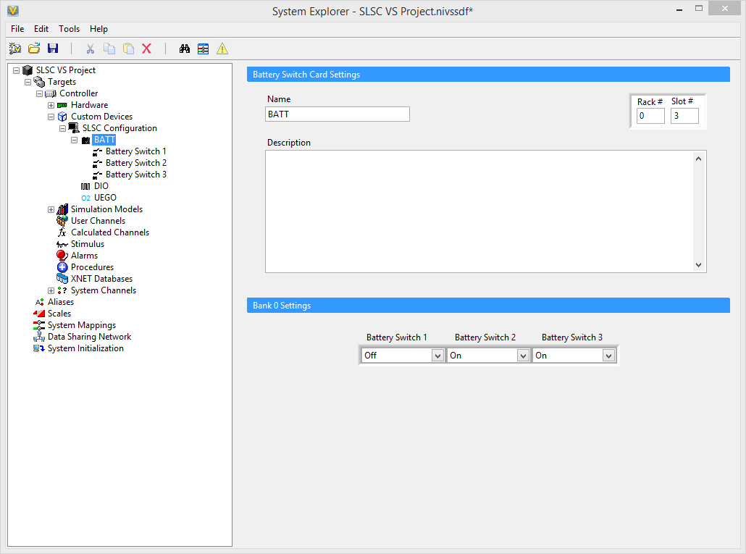
Battery Switch (LS-2-3010)
Purpose
Determines whether or not to send battery power to the 3 outputs
Notes:
The Battery Switch card is used to switch the output to battery power or not. You can set the initial state for each of the 3 switches in the main page of the Battery Switch card or you can update the switches individually in the channels. The user may also change the rack and slot position.

Slide 13

Current Sense Calibration (LS-2-2202)
Purpose
Places individual channels in the card in calibration mode in order to get the gain multiplier needed for calibration
Notes:
This card places individual channels in calibration mode in order to get the gain multiplier needed for the AI channels. The user can select Inactive which turns off calibration mode. The user also select Channels 1-16 to set place individual channels in calibration mode. It is recommended that the user create a calibration routine which sets the Calibration State to channels 1-16 for 100 ms to get the gain multipliers for each channel in a separate system definition. Then pull those values as Scales in the full system definition. The user may also change the rack and slot position.

Slide 14
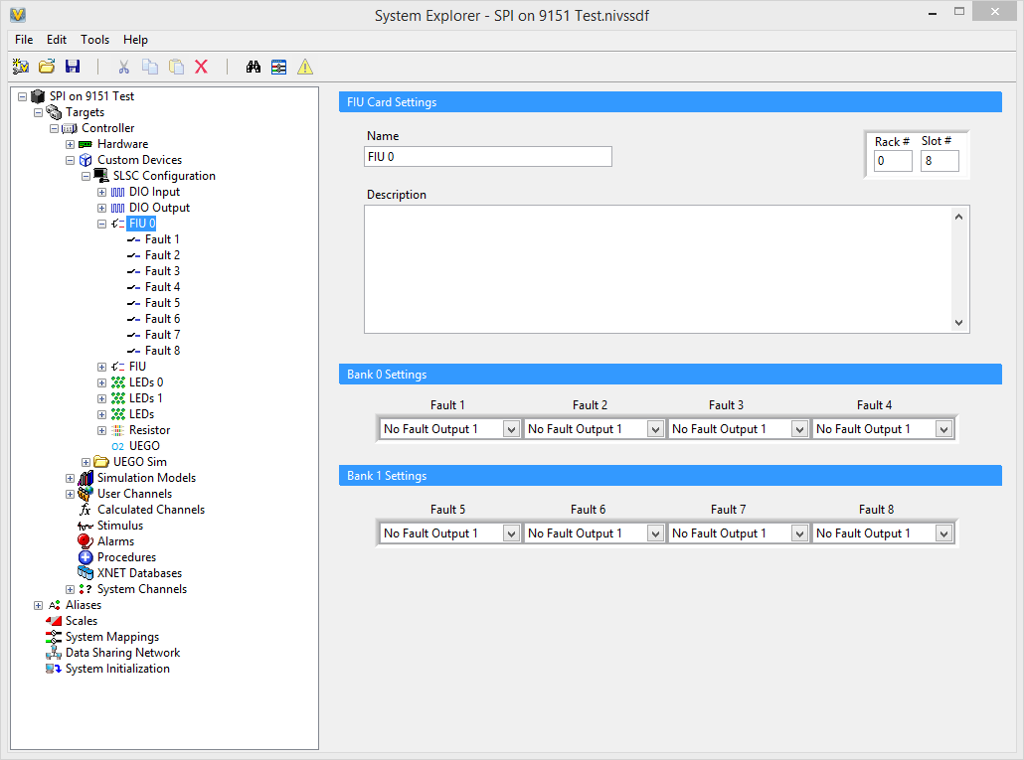
Fault Insertion (LS-2-2501/LS-2-2502)
Purpose
Uses 8 channels to insert faults into the system
Notes:
The FIU card is used to set the fault states of up to 8 channels. Fault states can be No Fault Output 1, Open Circuit 100 Hz, Ground 100 Hz, Open Circuit, Ground, Fail Rail 1, Fail Rail 2, and No Fault Output 2.
You can set the initial state for each of the 8 faults in the main page of the FIU card or you can update the fault states individually in the channels. The user may also change the rack and slot position.

Slide 15
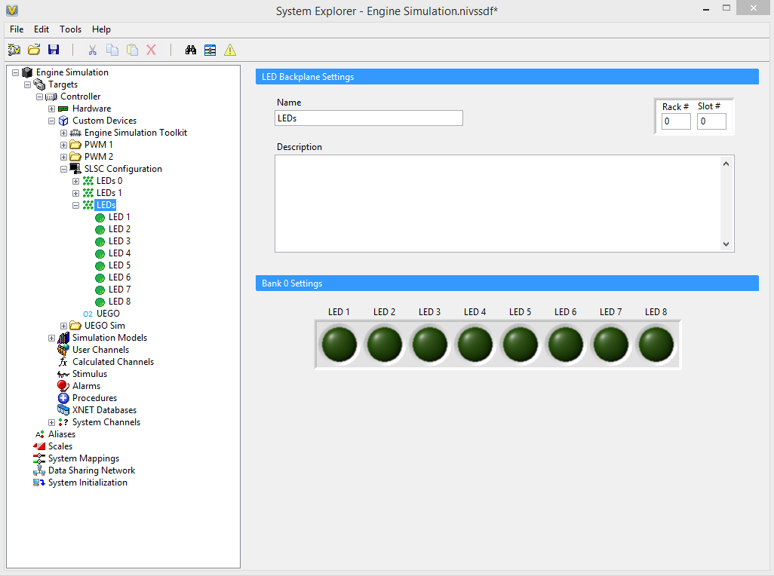
LED Backplane
Purpose
Illuminate 8 LEDs on the racks through the backplane
Notes:
LEDs on the backplane are for user feedback. The user can map digital lines to these LEDs.

Slide 16
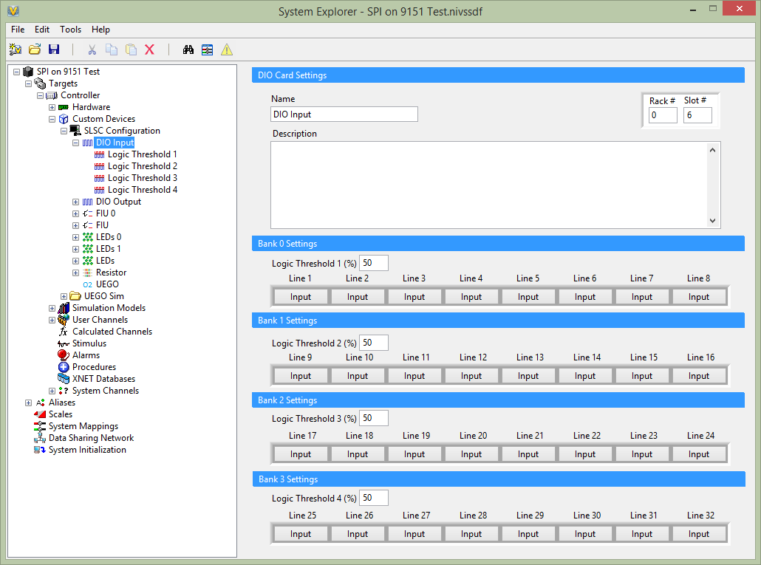
Digital Input/Output (LS-2-2101)
Purpose
Set the digital lines to be either inputs or outputs.
Sets the logic threshold of each bank of lines
Notes:
The DIO card is used to set the digital lines to either inputs or outputs. It also is responsible for setting the logic threshold for the pins. The logic threshold determines the voltage level of the pins relative to the reference voltage. The user may also change the rack and slot position.

Slide 17
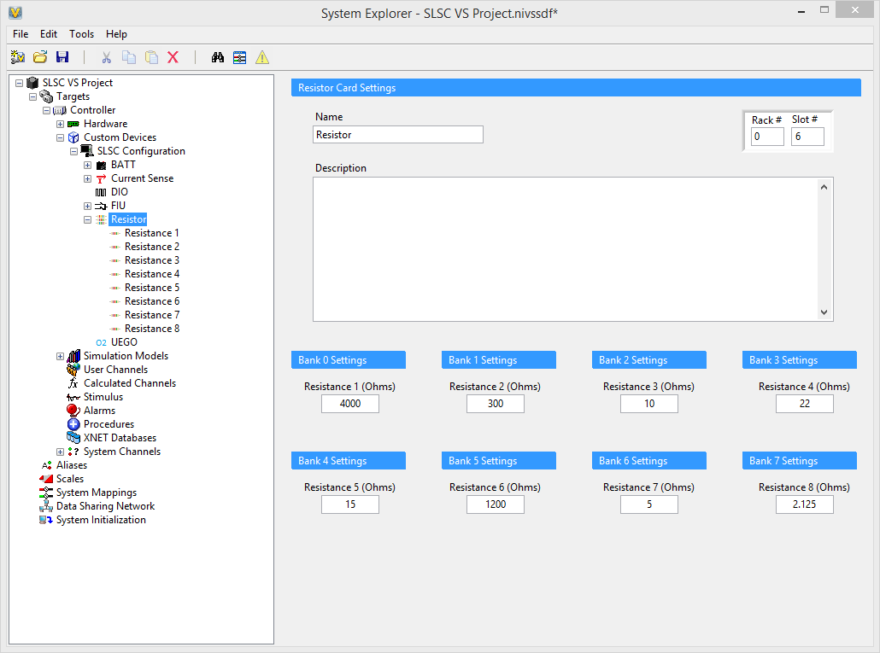
Simulated Resistance (LS-2-2901)
Purpose
Uses 8 channels to simulate resistances from 2 - 8193.875 Ohms
Notes:
The Resistor card is used to set the resistances of up to 8 channels. Resistances can range from 2-8193.875 Ohms (this is due to serializing resistors). You can set the initial state for each of the 8 resistances in the main page of the Resistor card or you can update the resistances individually in the channels. The user may also change the rack and slot position.

Slide 18
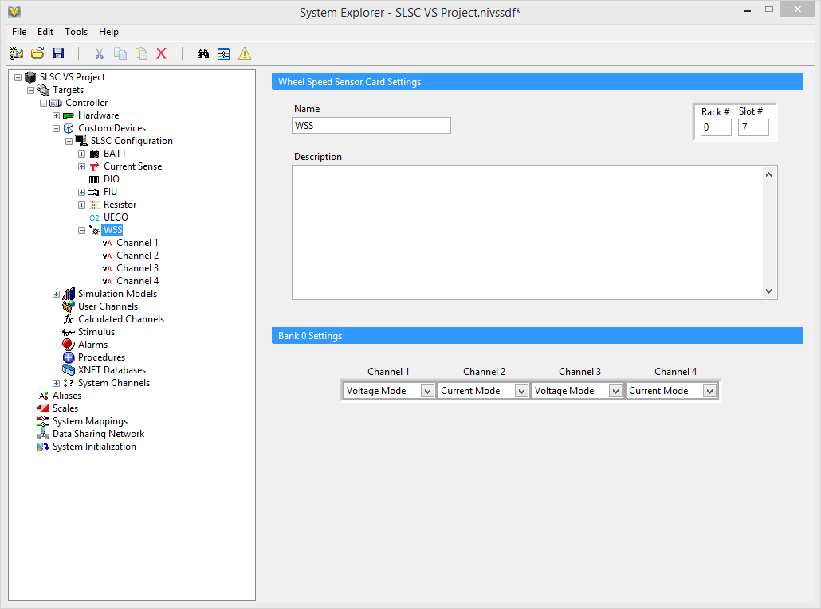
Wheel Speed Sensor (LS-2-2751)
Purpose
Uses 4 channels to set the mode to either voltage or current mode
Notes:
The Wheel Speed Sensor card is used to set the modes for 4 channels. Mode can be either Current or Voltage mode. You can set the initial state for each of the 4 channels in the main page of the Wheel Speed Sensor card or you can update the modes individually in the channels. The user may also change the rack and slot position.

